Slide 1
ORGANISATIONAL
BEHAVIOUR
CHAPTER-2
OB – THE EMERGING CHALLENGES

Slide 2
LEARNING OBJECTIVES
Issues confronting OB specialist in the days to come.
Ways of managing workforce diversity.
Changes in demographics of workforce.
Employee expectations have changed and the OB expert needs to be aware of such changes.
Globalisation and its impact on people management.
Changes in technology and its impact on people management.
The need to promote ethical behaviour.

Slide 3
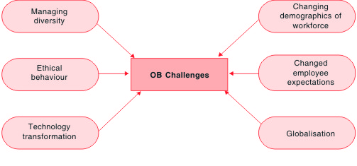
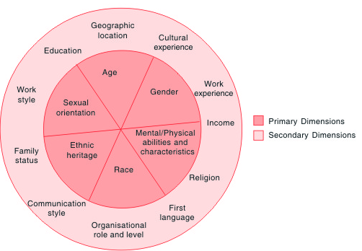
Primary and Secondary
Dimensions of Diversity
OB Challenges

Slide 4
Benefits from Managing Diversity
        Xerox plants using diverse work teams are now 30 per cent more productive than conventional plants.
        Procter & Gamble achieves 30-40 per cent higher productivity at its 18 diverse team-based plants than at its non-diverse plants.
        Motorola beat its competition by producing the world’s most efficient and high-quality cellular phones which are produced almost exclusively by diverse work teams.
        Research has shown that organisations that proactively recruit, develop, and leverage multinational leaders are in better positions in the global marketplace.
        KFC experienced phenomenal success when it introduced its kosher line of chicken menus in Israel.
        GE Power Systems achieved 13 per cent productivity gains from cross-functional and multicultural teams versus homogeneous teams.
        Numerous empirical studies of work teams demonstrate that when tasks are complex and not clearly defined, heterogeneous teams outperform homogeneous teams. ‘Super teams’, those that were diverse in numerous respects and selected because of their differences, outperformed those that were homogeneous.3
        ‘Unlike other MNCs, diversity for us is a business imperative and not an issue of legal compliance. We want HLL’s management to be representative of our diverse customer base so that they understand the needs of the customer better. If a manager understands the brand she is handling, the learning curve is that much shorter. For instance, in marketing, if the target audience is women, it is an advantage if a woman is incharge of the brand’. Says Prem Kawath, HR Manager, HLL.4

Slide 5
Barriers to Accept Diversity
        Prejudice - unjustified negative attitude towards a person based on his or her membership of a particular group.
        Ethnocentrism - a tendency to regard one’s own group, culture, or nation as superior to others. This is what sometimes occurs in a selective club, religious sect, or political organisation. People who are ethnocentric see their group-related customs or beliefs as ‘right’ and evaluate other, beliefs or practices against this yardstick.
        Stereotypes - set of beliefs about a group that is applied universally to all members of that group, such as ‘all poor people are uneducated’ or ‘all Asians are good at maths’. Stereotyping, whether positive or negative, is not good because seldom does one statement hold true for all members of a group.
        Discrimination - barring an individual from membership of an organisation or from a job because of his or her membership of a particular group. An example of unfair discrimination is the company that only interviews men for a position that requires a lot of travel.
        Harassment - consciously shunning or verbally or physically abusing an individual because of membership of a particular group.
        Sexual harassment - approaching a person in an unwanted, uninvited, intimate way, interfering with that person’s productivity or advancement.
        Backlash - negative reaction to the gaining of power and influence by members of previously under represented groups, leading to fear, resentment, and reverse discrimination.

Slide 6
Traits Associated with Gender Stereotypes
Male Female
Aggressive Affectionate
Autocratic Complaining
Capable Cooperative
Competitive Emotional
Coarse Easily influenced
Decisive Forgiving
Humorous Indecisive
Individualistic Illogical
Loud Mild
Objective Passive
Opportunistic Sensitive
Reckless Subjective
Tough-minded Tactful
Unemotional. Weak

Slide 7
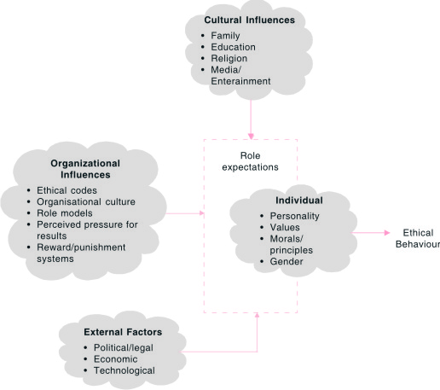
Ethical Behaviour in the Workplace

Slide 8
Whistleblowing in Action
Sl.No. Name of the Organisation Whistle blower Consequences
1 Enron Sherron Watkins Liquidation of the company
2 Kellogg India Senior Executive Sacking of two senior (Name not known) executives who were promoted for excellent performance a few
months before.
3 Director FBI,US Coleen Rowley Attack on the World Trade Centre, US
4 World.Com Cynthia Cooper Company gone bust
5 Xerox Name not known CFO made to pay $5.5 million in fines and banned by the SEC from practising accountancy. Accounting system streamlined
6 Heinz India, Installed whistle No incident is reported
Johnson and Johnson, blowing systems
Bayer India
7 LG India Names not known but Not known
10-12 cases have been
reported to head office,
South Korea

Slide 9
Means to Promote Ethical Conduct
India Asia Pacific Global
Ethics/Code of conduct 72 73 64
Pre-employment Screening 54 37 50
Public Source Information 32 25 33
Whistle blowing system 28 18 28
Fraud Training 24 25 29
Others 23 20 27
Note: Figures indicate percentage responses from sample firms who have
implemented the systems.

Slide 10
Acts Prohibited by Ethical Codes
Extortion, gifts and kickbacks
Conflict of interests
Illegal political payments
Violation of laws in general
Use of insider information
Bribery
Falsification of corporate accounts
Moonlighting
Revealing company secrets
Ignorance of work-related laws
Fraud, deception
Justifying illegal behaviour that serves the company

Slide 11
Difficulties in Decision-making
        Managers face, as stated earlier, dilemmas in deciding on a course of action.
        Managers confront situations where a distinction between facts and values has to be made while making ethical decisions. Facts are statements about ‘what is’ and values are statements about ‘what ought to be’. ‘What is’ can never define ‘what ought to be’. For example, the cost of researching, developing, and producing a life-saving drug may necessitate paying a high price, as far as the company is concerned. But this price may be perceived as exploitative by users.
        The good and evil exist simultaneously, in tandem, and are inter-related. Nestle’s sales of infant formula in Kenya and Zambia have led to infant deaths as mothers mixed the powdered food with contaminated water and their babies died of dysentery. But evidence also shows that the same formula has saved other infants. Evils should be minimized if not altogether eliminated.
        Knowledge about the consequences of an action is limited. One of the principles of decision-making is utilitarian. This implies that if an act results in the greatest good of the greatest numbers, it is taken as morally acceptable. This principle assumes that the consequences of the act are defined. But in an uncertain environment, consequences cannot be easily predicted.

Slide 12
Difficulties in Decision-making …. Contd
        Antagonistic interests frequently use incompatible ethical arguments to justify their intentions. Thus, the ethical stand of an organisation is often based on entirely different premises from the ethical stand of critics. Animal lovers may argue against slaughter on the ground that animals are entitled to rights similar to those enjoyed by humans, including the right to live. Poultry growers, on the other hand, contend that raising animals for food ensures benefits to society.
        Some ethical standards vary with the passage of time. Donations to political parties were forbidden earlier, but it is now allowed. In addition, certain bribes and payments which are accepted practices in the Asian, African, and Latin American countries are not regarded as ethical in the US. Doing business with close friends and family is standard practice in the Arab world, but is treated as nepotism in Western Europe.
        Ethical behaviour is moulded from the clay of human imperfection. Unethical practices abound everywhere (see Fig.2.7 for different crimes). An honest OB manager finds himself or herself like a babe in the woods, not able to do anything, surrounded as he or she is, by dishonesty everywhere.
        The early 21st century presents managers with newer and emerging ethical problems that are not solved easily with traditional ethical guidelines. For example, modern ethical theory has not yet developed an adequate principle for weighing human life against economic factors in a decision. Cancer studies may predict that workers exposed to chemicals will become ill in small numbers far in the future. How should this information be balanced against costs of regulation, capital, investment or job loss?

Slide 13
Summary
        As we go into the future, OB experts confront several challenges while managing interpersonal relations in organisations.
        Organisations are becoming increasingly cosmopolitan. If a diverse workforce is managed effectively, firms gain competitive advantage. OB experts need to create diversity awareness, enhance diversity skills, and commit top management to diversity. These are only some ways of managing diversity.
        Dual-career couples, growing number of young employees, more and more working mothers, and decline of blue-collar workers are the changes in the profile of the workforce in any organisation. These developments have their own implications for OB specialists.
        Employees are no more attracted by mundane benefits like pay rise and job security. They are motivated by career prospects, challenging jobs, empowerment, and the like. OB specialists need to take care of these developments.
        Globalisation benefits skilled employees. Competent employees are in great demand. Attracting and retaining capable employees is a big challenge to OB experts.
        Technology makes certain firms more sensitive and their management is a big task.
        As competition becomes severe, organisations tend to compromise on ethics. Enforcing ethical behaviour on managers and workers is yet another challenge for OB specialists

